Slide 1
Gene and WHOLE Genome Duplication in crop Plants
Simon Renny-Byfield
Department of Plant Sciences
University of California, Davis
August 20th 2015

Slide 2
Overview
A brief bio
Paleogenomics and gene loss
Population genomics of copy-number variants
Gene expression following whole genome duplication

Slide 3


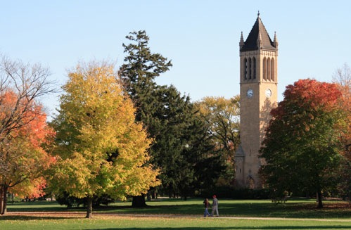



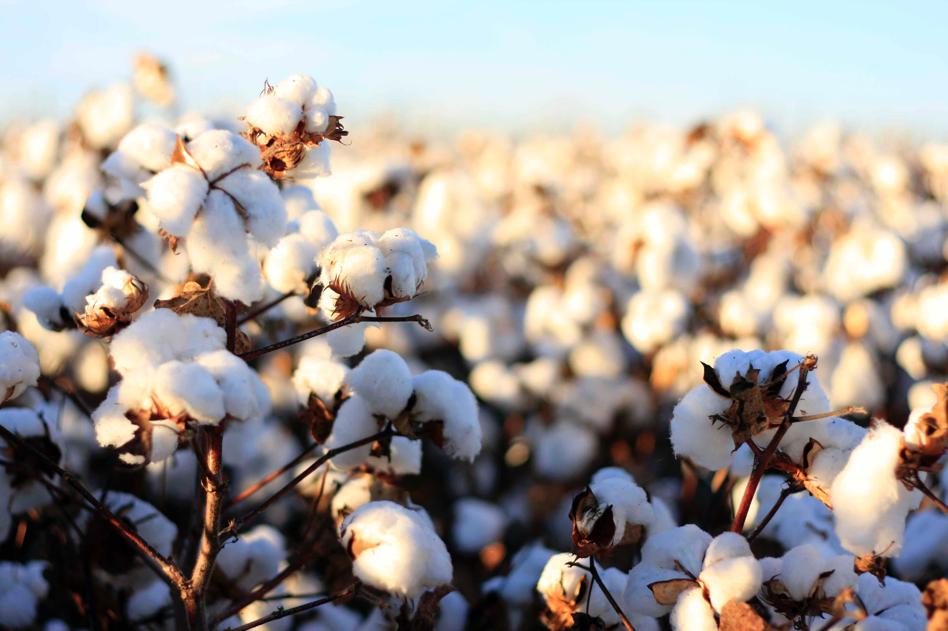
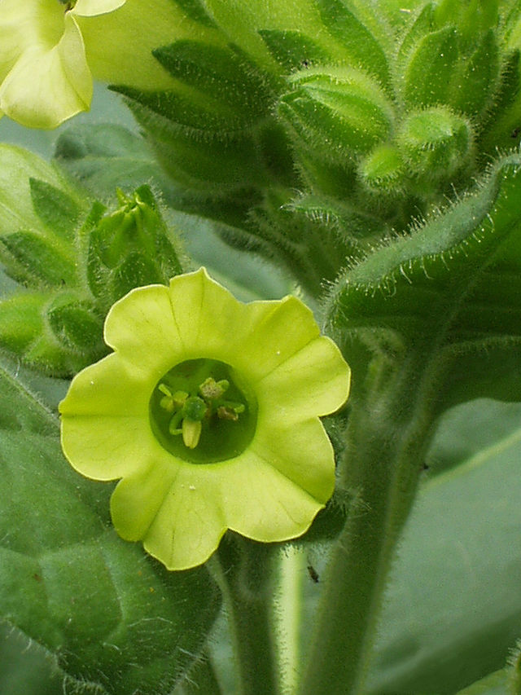

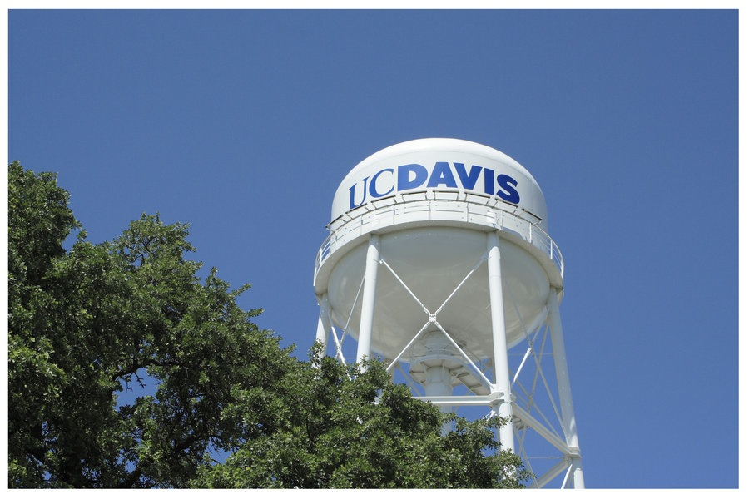
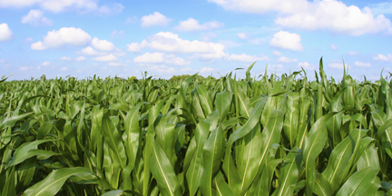
Biography

Slide 4
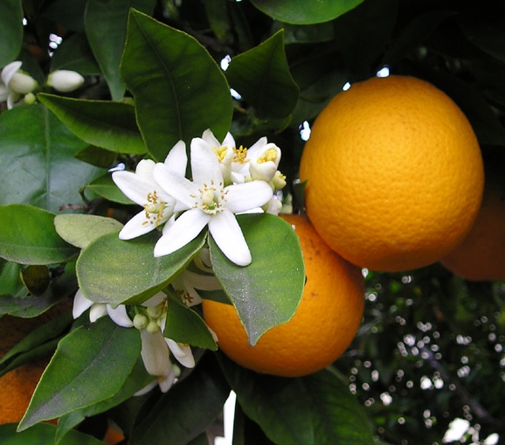
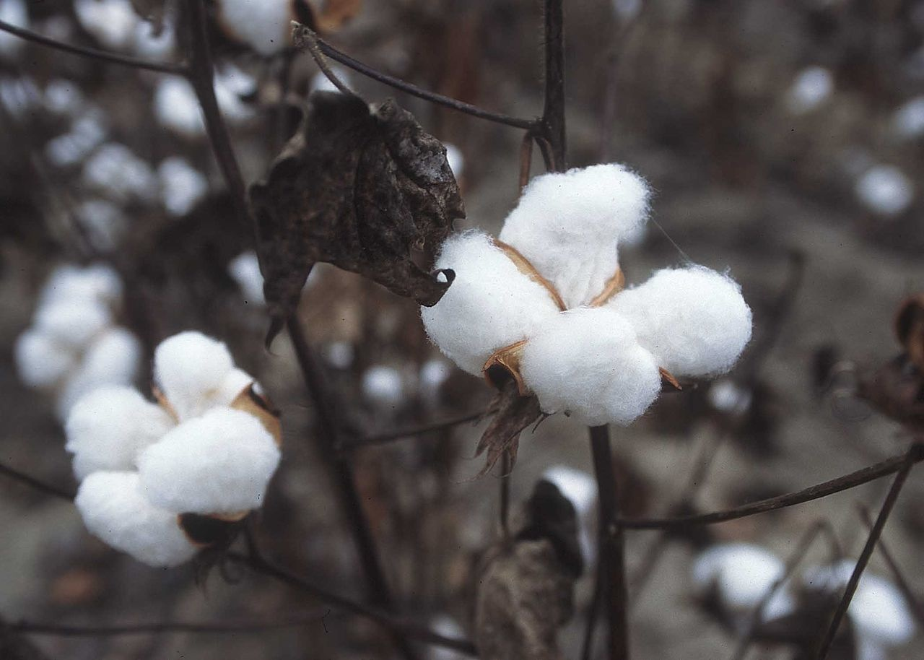
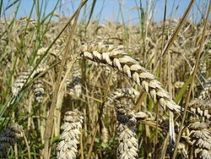
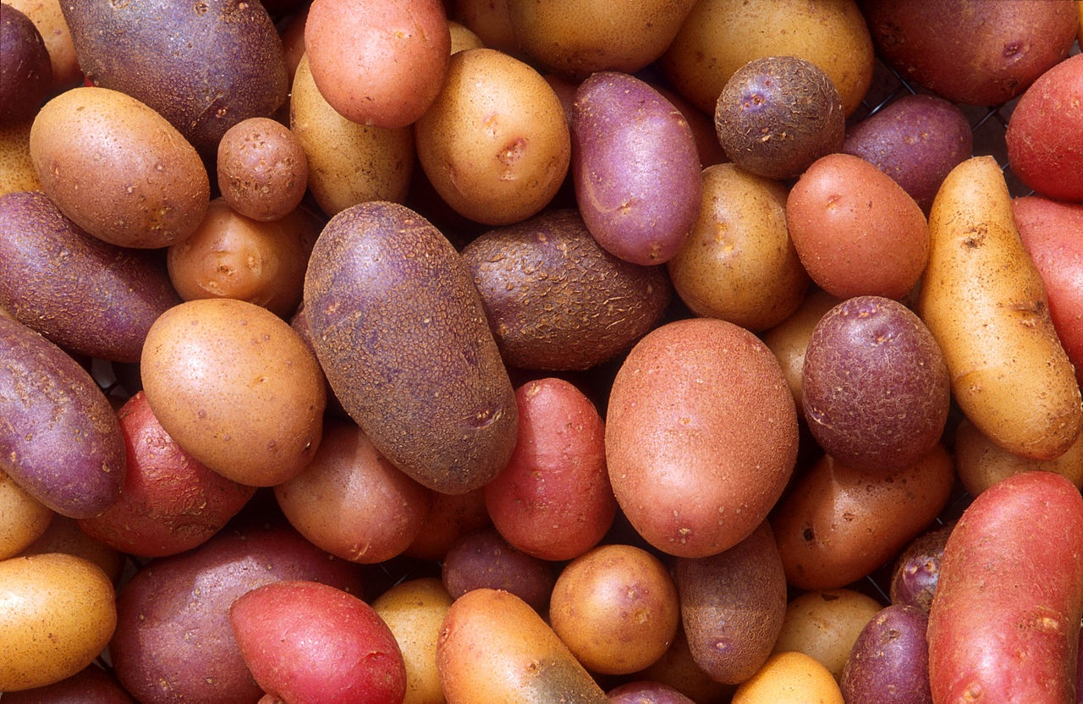
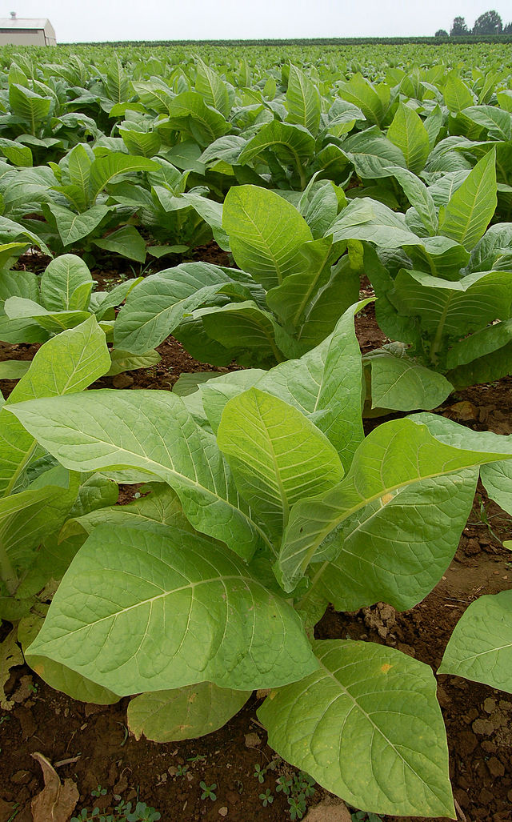
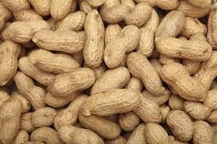
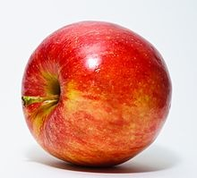
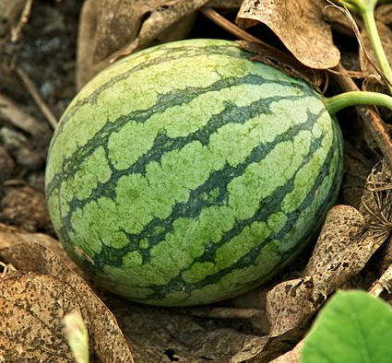
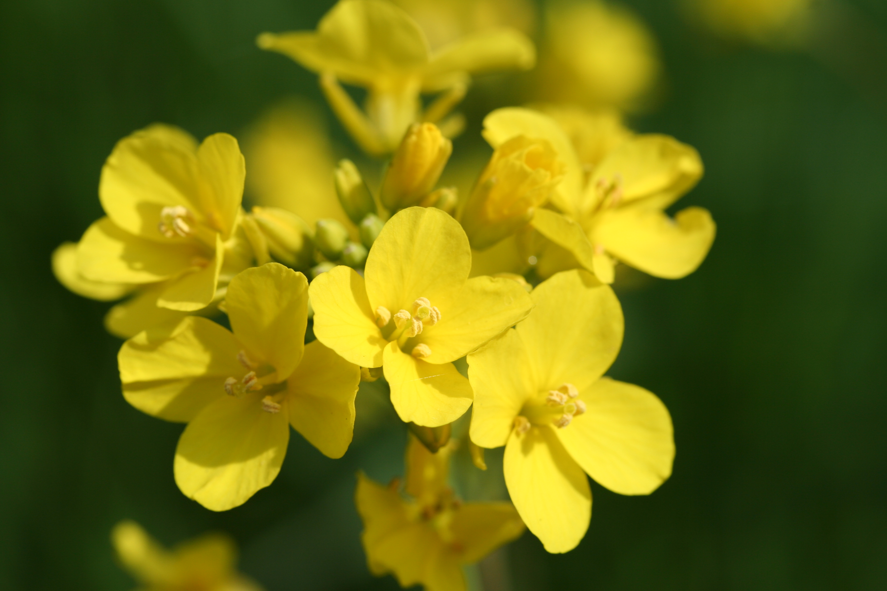
PolyPloid crops

Slide 5
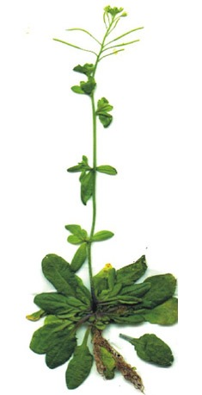
the dark secret of the angiosperms
Model “diploid” with n= 5
comparative genomics reveals α and β WGD events

Slide 6
the dark secret of the angiosperms
Schnable et al., 2011 PNAS

Slide 7
the dark secret of the angiosperms
Renny-Byfield and Wendel, American Journal of Botany, 2014

Slide 8
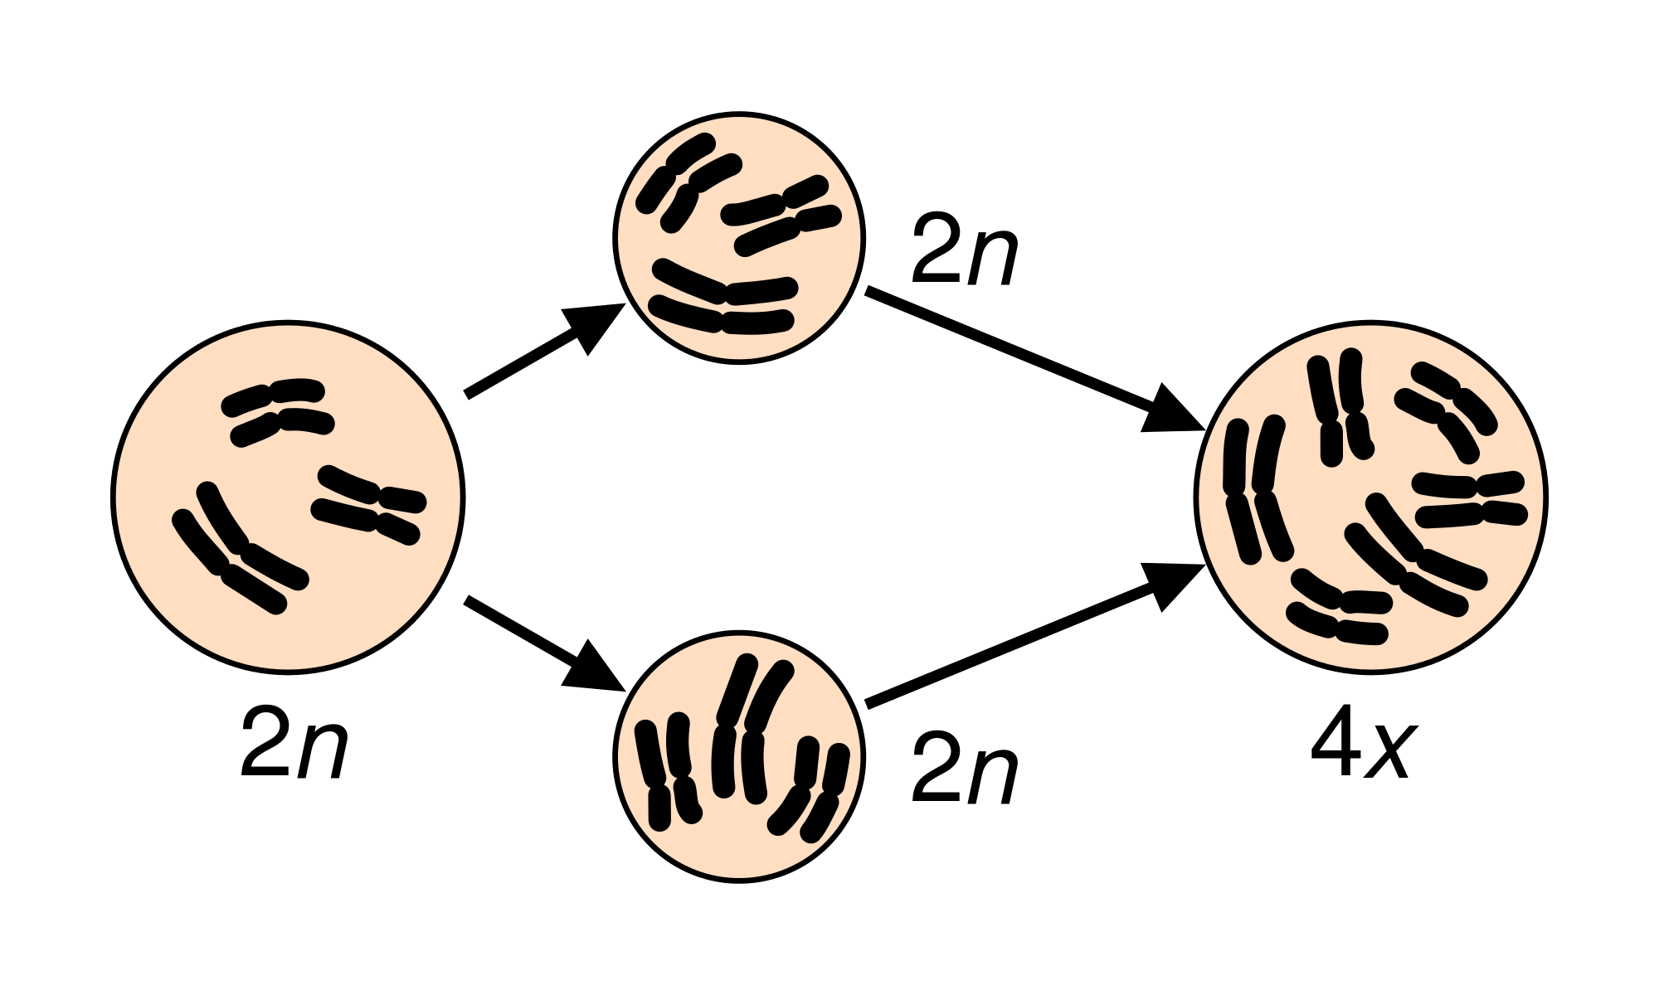
Whole genome duplication
Autopolyploidy
Allopolyploidy

Slide 9
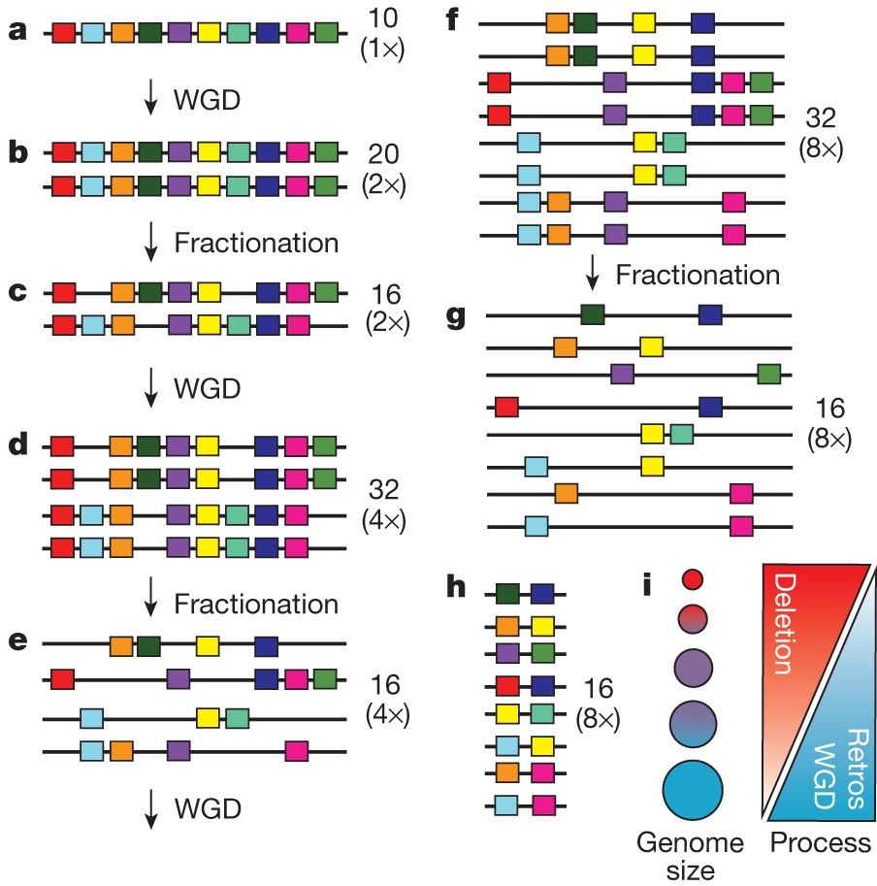
1. gene loss following wGd
All angiosperm lineages have at least one WGD in their ancestry
WGD followed by gene
loss is cyclical.
Ibarra-Laclette et al., Nature 2013

Slide 10
Ancient WGD in cotton
Original gene collection
Duplicate gene collection
Ibarra-Laclette et al., Nature 2013

Slide 11
Ancient WGD in cotton
Renny-Byfield et al., 2015 MBE

Slide 12
Gene fractionation
X
X
X
X
X
X
X = gene deletion

Slide 13
Bias Gene fractionation
Least Fractionated
X
X
Most Fractionated
X
X
X
X
X
X

Slide 14
Bias fractionation
Least
Fractionated
Most
Fractionated

Slide 15
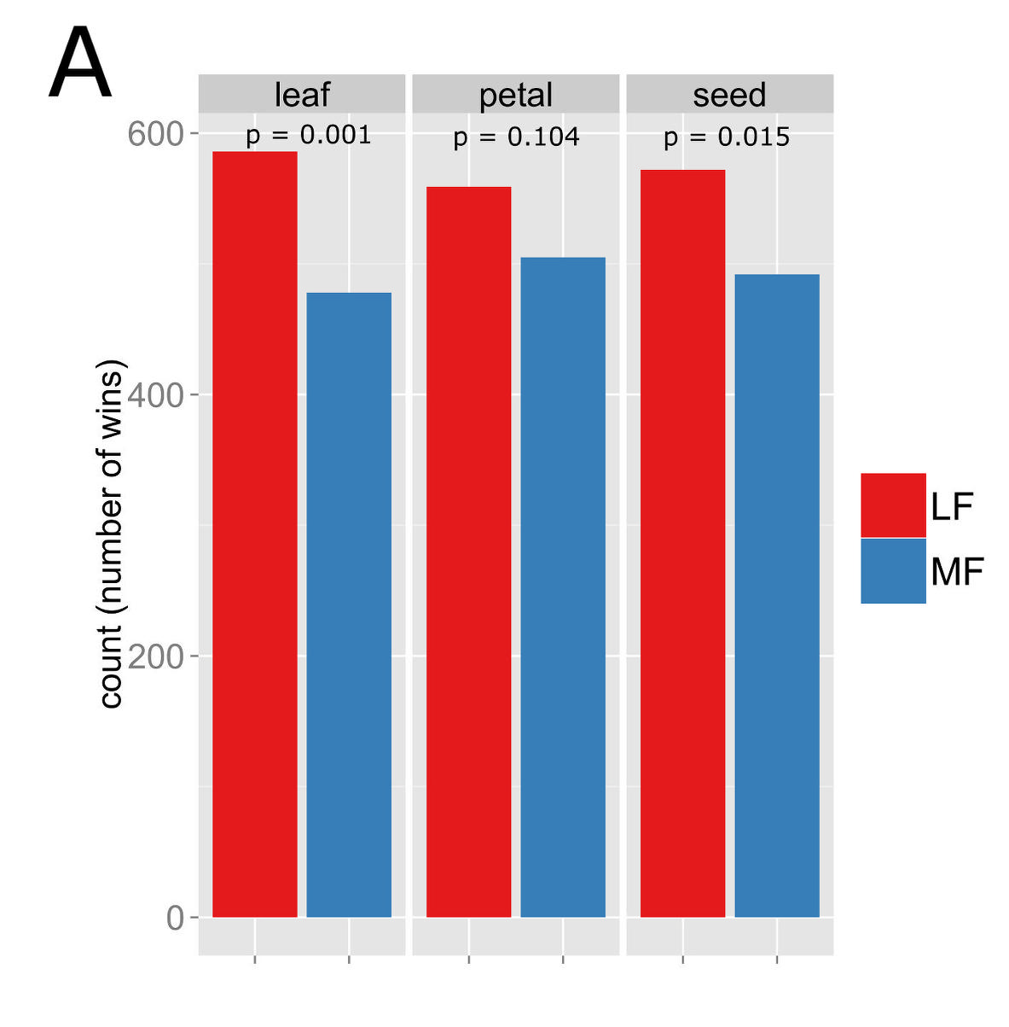
Gene Expression

Slide 16
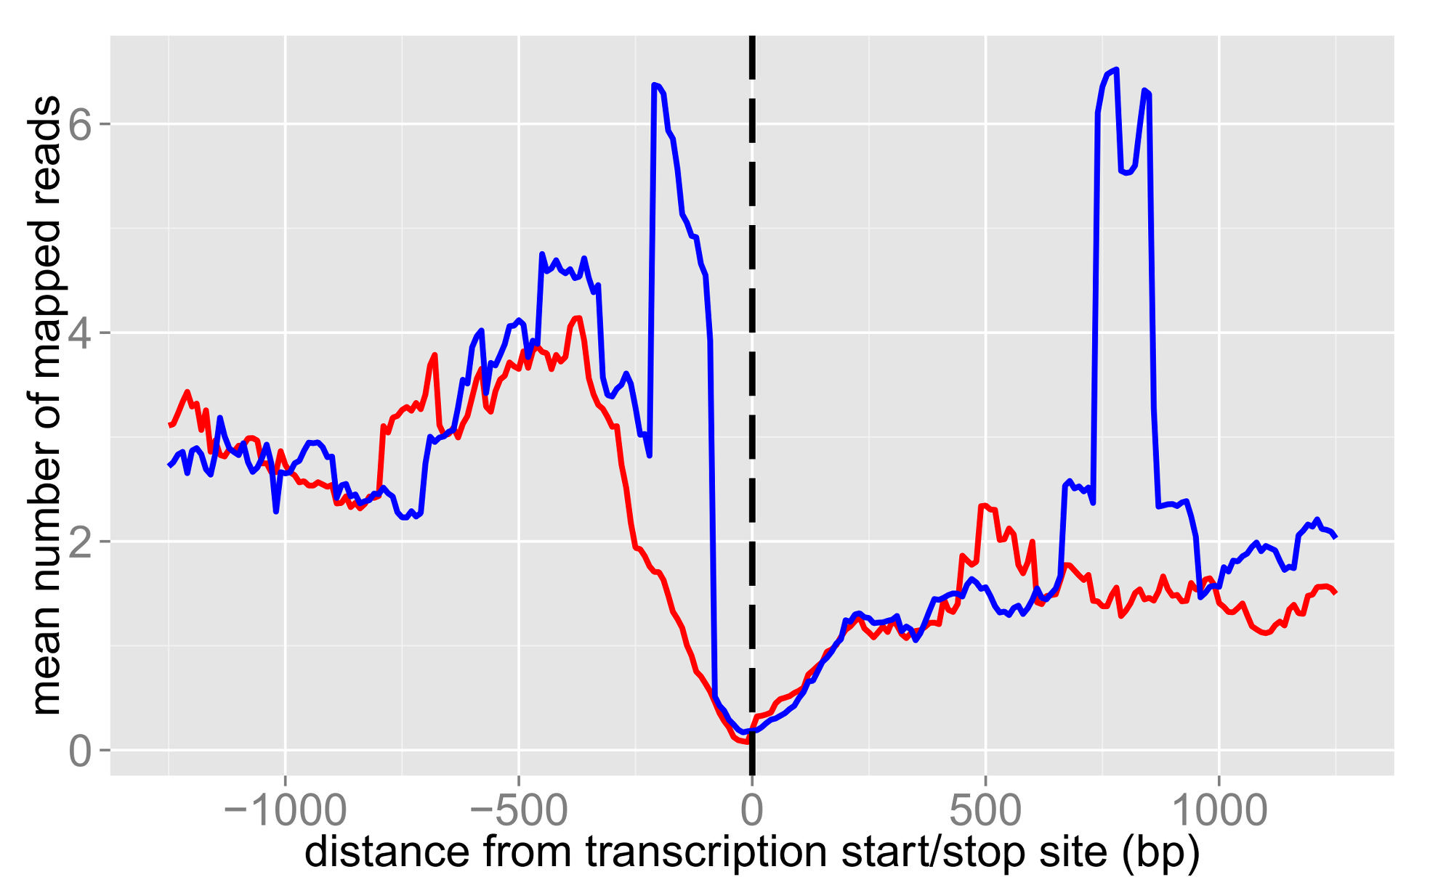
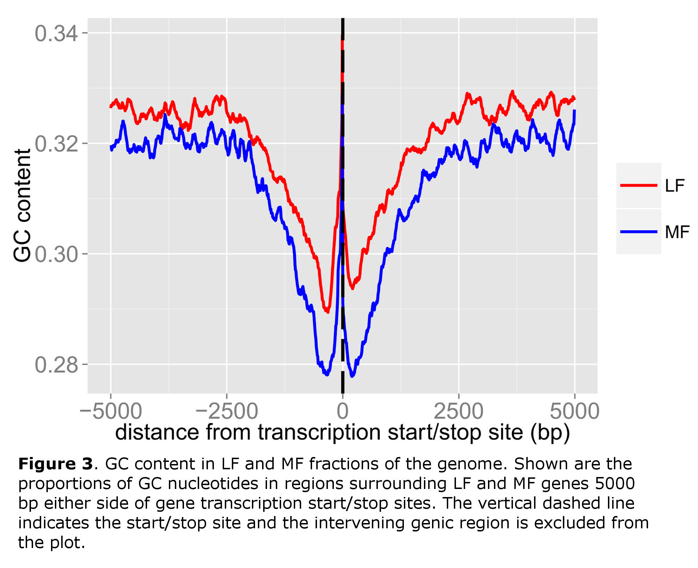
siRNA ENRICHMENT

Slide 17
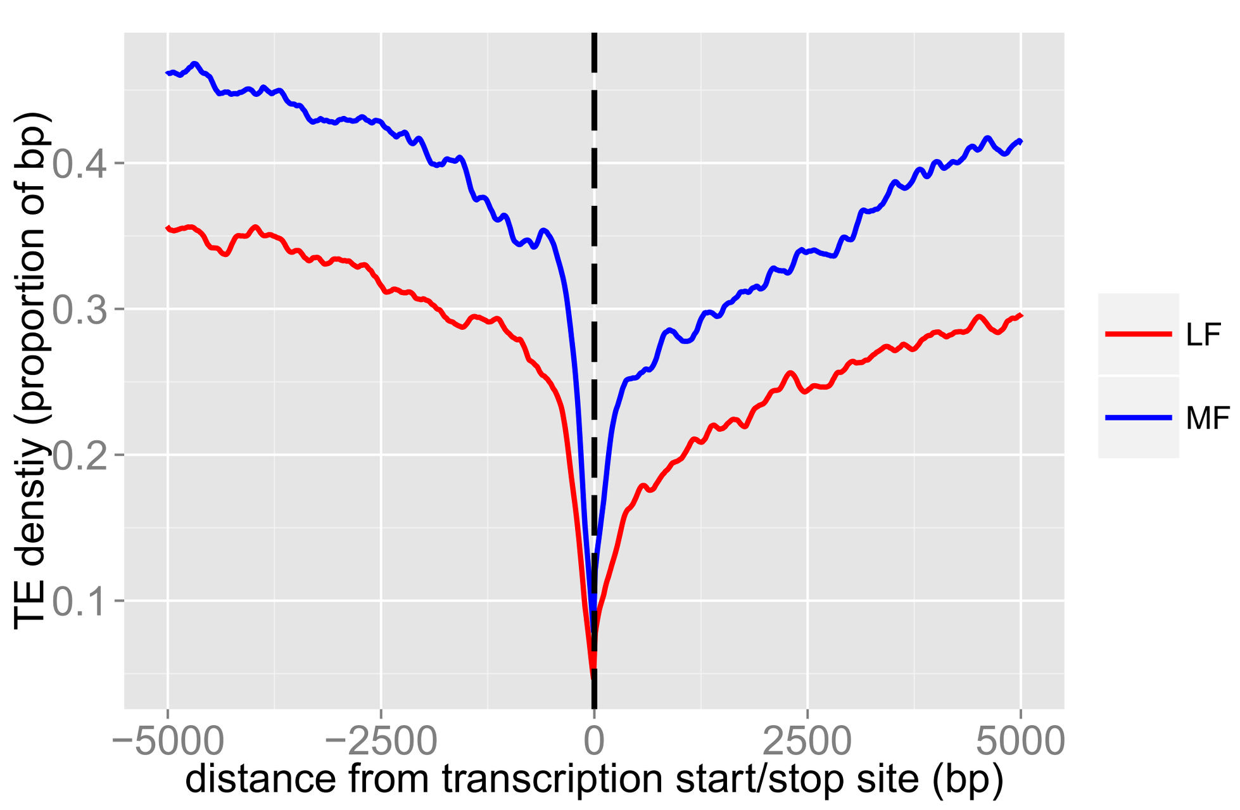
transposable elements and gc content

Slide 18
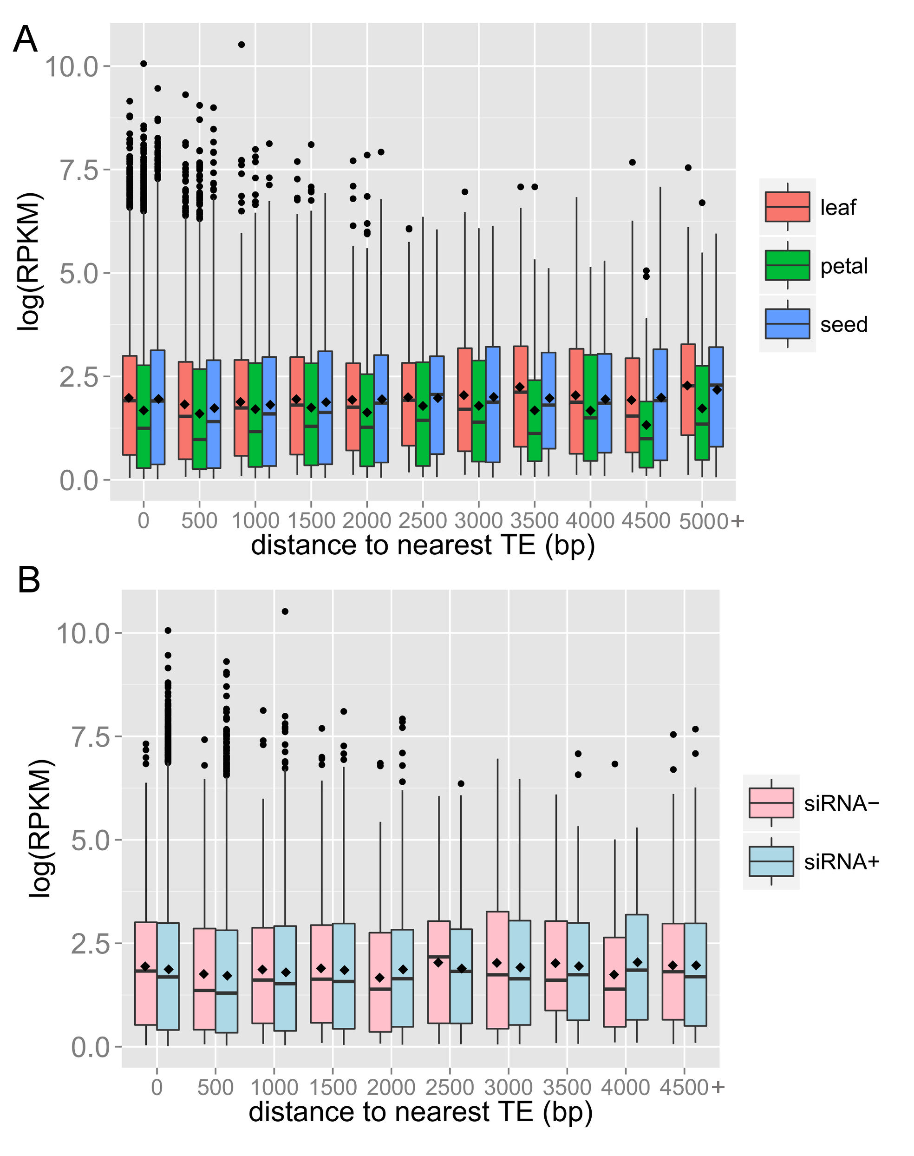
TEs, siRNAs AND GENE EXPRESSION

Slide 19
SUMMARY part 1
Evidence of bias in gene loss following WGD.
Associated with over expression of genes on regions experiencing less gene loss.
siRNAs are targeted to regions that have experienced more gene loss.
Little evidence that siena targeting results in down-regulation of nearby genes.

Slide 20
2. copy-number variants in wild maize (teosinte)
Renny-Byfield and Wendel, American Journal of Botany, 2014

Slide 21
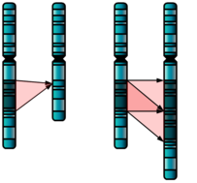
copy-number variants (cnvs)
Structural variation (SV) relative to a reference genome.
can be 2-3 bp to Mb in size.
genes can segregate as CNVs.
Deletion
Insertion
Maize, Arabidopsis, Rice, Sorghum, Soybean

Slide 22
cnvs
species | gene(s) | phenotype | reference
wheat | Vrn-A1, Ppd-B1 | flowering time | Diaz et al., 2012
 | Rht-D1b | dwarf phenotype | Li et al., 2012
soybean | rhg1-b | nematode resistance | Cook et al., 2012
cucumber | 31 kb deletion | sex determination | Zhang et al., 2015
CNVs can impact phenotype.

Slide 23
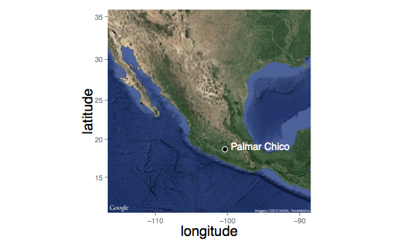
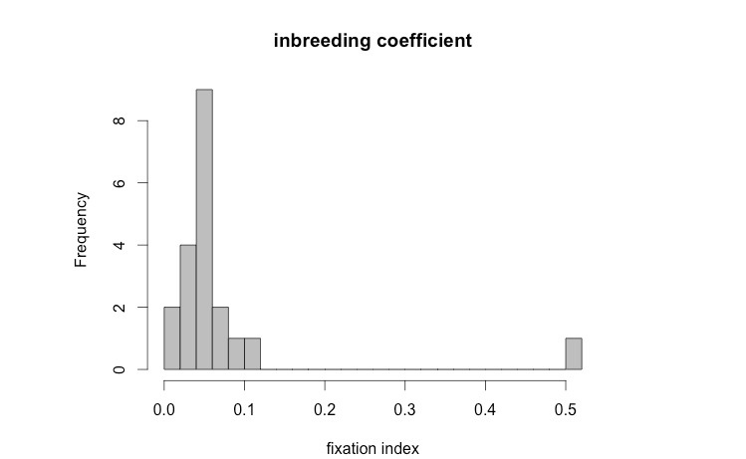
19, individuals near Palmar Chico, Mexico
Ne ~ 1,000,000
25-30 x WGS

Slide 24
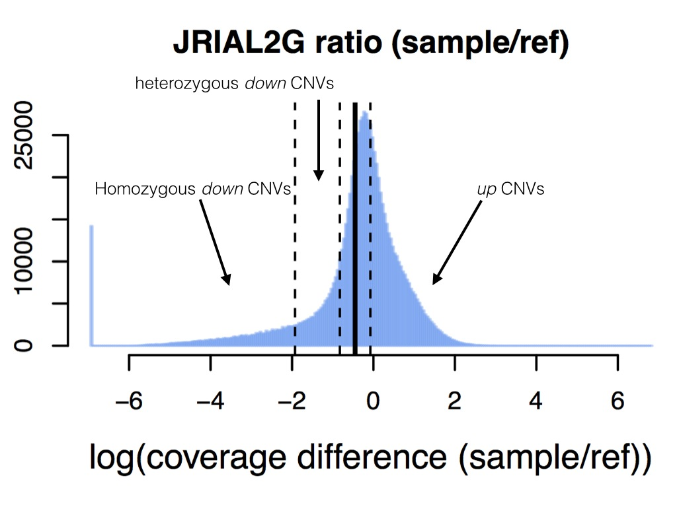
cnv identification
coverage over 1000 bp windows
compare sample to B73 reference
outliers in distribution of called CNV

Slide 25
site frequency spectrum

Slide 26
cnvs genome-wide
>127 Mbp of the genome called as CNV

Slide 27
cnvs genome-wide

Slide 28
CNVs: chr 6
SweepFinder
extended haplotype homozygosity (eHH)
Evidence of selection around “deletion”

Slide 30
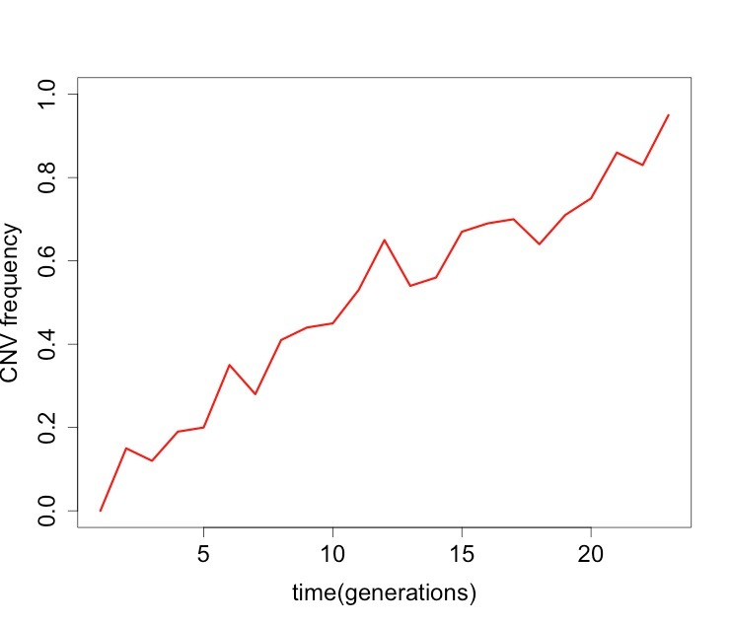
CNVs: Population genetics
Reduction in N_{e} at CNV locus
TD ~ background level
TD > background level

Slide 31
CNVs: Population genetics

Slide 32
CNVs: Population genetics

Slide 33
summary: part 1

Slide 34
3. Gene expression in polyploid cotton

